Slide 1

LEADING A HEALTHY LIFESTYLE
Dr. Bhavana Y. Chauhan
Dean & Principal
Charuter Vidyamanadal`s
S.M.Patel College of Home Science
Sardar Patel University
Vallabh Vidyanagar
byc1008@gmail.com

Slide 2
INTRODUCTION
What are the Benefits of Healthy Eating?
Helps us grow and develop properly
Helps to reduce the risk of developing diseases like heart disease, diabetes, obesity and cancer
Helps us to look, feel and perform better

Slide 3
Health Behaviour
‘Noun: An action taken by a person to maintain, attain, or regain good health and to prevent illness. Health behaviour reflects a person’s health beliefs’

Slide 4
‘The Holy Four’
Some researchers termed the following the holy 4 as they have a big impact on disease:
Smoking
Drinking
Nutrition
Physical Activity

Slide 5
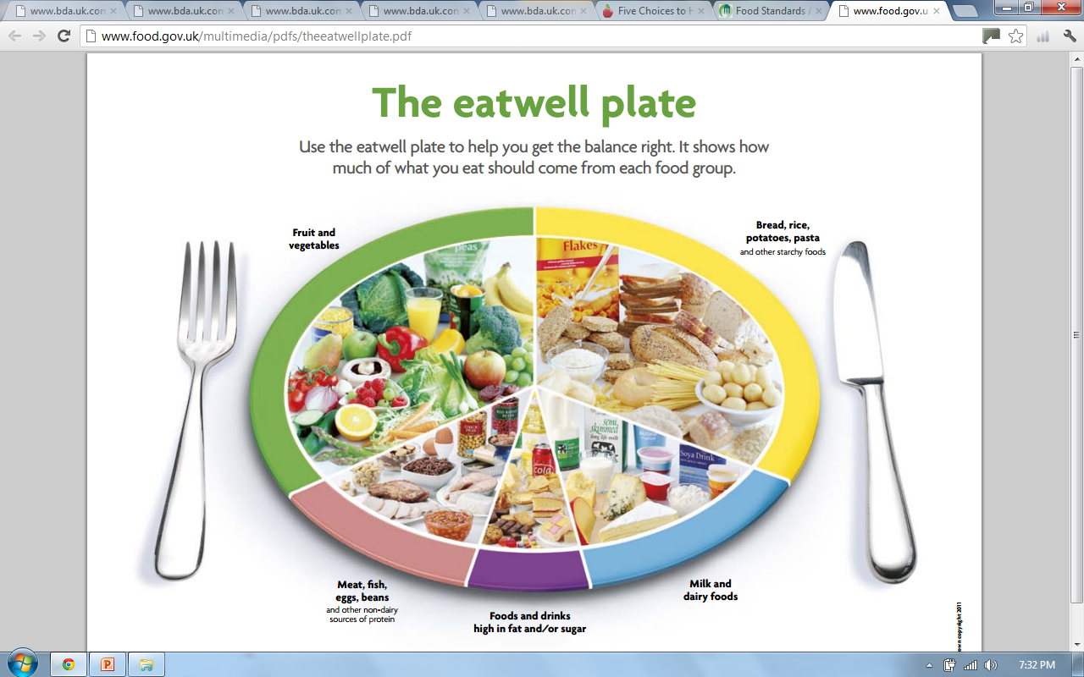
Food Standards Agency, 2007
Notes:
The eatwell plate shows how much of what most adults eat should come from each food group. This includes everything you eat during the day, including snacks.
So, try to eat:
– plenty of fruit and vegetables
– plenty of bread, rice, potatoes, pasta and other starchy foods – choose wholegrain varieties whenever you can
– some milk and dairy foods
– some meat, fish, eggs, beans and other non-dairy sources of protein
– just a small amount of foods and drinks high in fat and/or sugar

Slide 6

Nourish Yourself!
The next section will discuss ways in which a healthy diet is achievable;
  Based on current guidelines
  Evidence based
  Cover a wide range of aspects of a healthy diet
  Think of your body as a car; you wouldn’t fuel your petrol car with diesel (on purpose!)

Slide 7
Meal Pattern
Regular balanced meals are recommended
Missing meals may result in higher quantities of high energy foods being craved and consumed
Plan ahead
Meal times are a good opportunity to get the family together
‘Breakfast is the most important meal of the day’ - break the fast!
  people who consume a fortified breakfast cereal tend to have higher intakes of vitamins and minerals

Slide 8
Lifestyle & Women’s Health
  Leading threats to women’s health:
  Heart disease
  Stroke
  Cancer
  Chronic lower respiratory disease
  Contributing lifestyle factors: Screenings/Primary Care
  Stress Management
  Sleep
  Physical Activity
  Nutrition

Slide 9
Nutrition for Women
  Important Nutrients Iron
  Calcium
  Vitamin D
  Omega 3 fatty acids
  Phytoestrogens
  Weight Management Hormones & health
  Strategies for a healthy weight
Dietary Strategies for Managing Menopause
Nutrition Beyond Middle Age

Slide 10
Beverages
Satisfy your thirst with water.
Soft drinks, fruit drinks, sports drinks, buttermilk and sweetened hot and cold drinks add extra calories, sugar, and caffeine.
Water promotes hydration without extra calories.
Drink more in hot weather or when very active.

Slide 11
Vegetables and Fruit
Provide carbohydrate, vitamins A and C, magnesium and potassium as well as some B vitamins such as folate
Naturally low in fat and calories
Diets rich in vegetables and fruit are linked with lower risk of cardiovascular
disease and some types of cancer
• Directional Statements:
Eat at least one dark green and one orange
vegetable each day.
➢ vegetables and fruit more often than juice.
Choose vegetables and fruit prepared with little or
no added fat, sugar or salt.

Slide 12
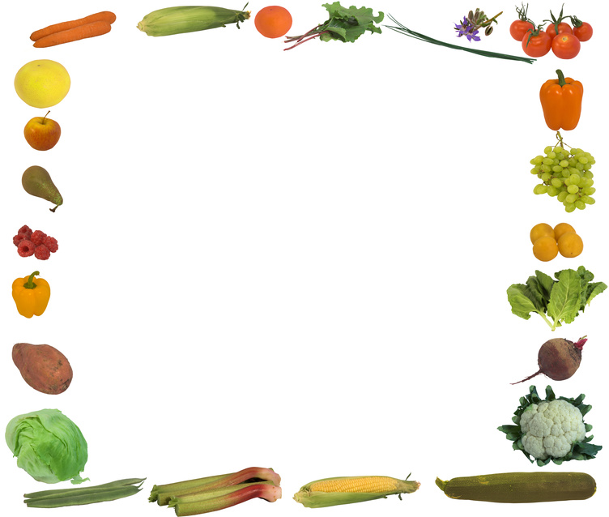
Why 5 a Day?
400g fruit and vegetables a day can help us to stay healthy
Great source of antioxidants, vitamins and minerals
Make a good healthy, handy and sometimes cheap snack i.e. banana,papaya!
Help to prevent constipation due to their high dietary fibre content
May reduce risk of cancer, heart disease and stroke
Notes:
Antioxidant – a substance that protects our cells from oxidative damage (i.e. it prolongs the health of our cells). This diet provides a healthy intake for our whole body system, even down to our individual cells!

Slide 13
Carbohydrates
Q: What are they?
A: Sugars and starches that provide our bodies with energy (calories) to function
Dietary sources come in two forms;
Simple
  Fructose (fruit sugar), sucrose (table sugar), lactose (milk sugar) and glucose
  Sweets, sugary pop
Complex/starchy
  Bread, flour, rice, pasta, breakfast cereals
  Good source of calcium, iron and B vitamins
Notes:
Simple carbs have 1 or 2 units of sugar. Easier for body to break down to glucose so get absorbed into blood quicker
Complex/starchy made of many units of sugar. Take longer to be metabolised so they provide a slower release of energy.

Slide 14
Fruit and vegetables and pulses also provide carbohydrates; a mixture of starches and sugars
Recommended dietary intake: 33% starchy carbs, 50% total carbs
Our bodies store unused carbohydrate in the liver and muscles but when full, excess carbohydrate is stored as fat
  Too little carbs → weakness, poor concentration (not enough fuel to the brain), constipation
Notes:
-XS CHO stored as fat, highlights why we need to eat it in the right proportions

Slide 15
Q: Are carbohydrates fattening?
A: Gram for gram carbohydrates contain less than half as many calories as fat.
  Cooking methods affect the calorie content of carbohydrate foods, as does adding fats and oils to taste eg: Potatoes
  Q: What about low carbohydrate diets?
  A: Low carbohydrate diets don’t represent each food group. Our body quickly moves from obtaining energy from fat stores onto digesting muscles
Notes:
Frying and roasting will mean the cooked carbohydrate product now has much more energy than if it had been boiled, steamed or grilled.
Low fat diets tend to be higher in bad fats too which can increase the risk of heart disease.
- Research shows high carb diets are most beneficial to health

Slide 16
  May risk of type 2 diabetes, heart disease and some cancers
Aim for 3 servings daily
Low ‘GI’ (slow release of energy) which may keep you fuller for longer
Look out for ‘Whole’ before the name of the cereal
  Ideas:
    Wholegrain cereals and cereal bars with yoghurt or milk for breakfast or as snacks
    Wholemeal, granary, multigrain bread instead of white
    Oatmeal and whole-oats to make flapjack
    Quinoa, bulgur wheat, brown rice in salads or with curries

Slide 17
Protein: Meat, Fish and Alternatives
  Moderate amounts
  Choose low fat/lean options where possible
      Cut visible fat off meat products and avoid poultry skin
  Try avoid processed meat products due to their high saturated fat content
  Fish twice a week (not fried!), one oily
  Eggs – FSA puts no limit on intake
  Mycoprotein (QuornTM), soya protein and tofu are also good low fat protein sources
Notes:
-Poultry meat has increased considerably in fat content over recent years. White breast meat with no skin has the least amount of fat.
- Omega 3 sources in descending order of quantity of omega 3
- Eggs contain dietary cholesterol however this has little effect blood cholesterol levels

Slide 18
Protein: Milk and Dairy
2-3 portions daily
Milk (1/3 pint), cheese (40g), yoghurt (1 pot)
Healthy adults should choose low fat options if possible
Plant based alternative milk drinks i.e. soya better to get fortified sugar free version
Snack/dessert idea:
  Try plain yoghurt with strawberries or blueberries for sweetness or adding it to curries instead of cream
Notes:
Low fat dairy products contain the same amounts of calcium and protein as their full fat alternatives but less fat and energy
Research suggests soya milk may be beneficial in lowering bad cholesterol

Slide 19

High Fat/Sugary Foods
<8% of intake
Can be consumed as part of a healthy balanced diet
Include crisps, sweets, cakes, biscuits, sugary drinks
Provide relatively little nutritional benefit
Many are highly processed so may contribute a large amount of salt to the diet

Slide 20
Fat
We need some fats in our diet as they provide energy and some vitamins. Some our body cannot make; essential fatty acids (EFAs)
Saturated (animal products)
Trans (cakes/biscuits)
↑ blood cholesterol
Monounsaturated (olive/rapeseed oils, avocados)
Polyunsaturated (sunflower, corn, sesame oil)
  ↓ blood cholesterol
Notes:
Saturated – hard at room temp
Trans – veg oils that have been processed to make them hard (on ingredients list as partially hydrogenated veg oil)
It is recommended to reduce sat & trans fats and increase mono and polyunsaturated fats for heart and overall health.

Slide 21

Omega 3
EFAs: our body cannot make them so we have to obtain them through dietary sources
Sardines
Salmon
Mackerel, kippers
Herrings
Tuna
Swordfish
Any fish/sea food
Plant sources linseed, walnuts and walnut oil
Healthy Heart
Notes:
Tinned tuna – canning process removes omega 3

Slide 22
How to saturated fat intake
Grill, boil, steam or poach instead of frying and roasting
Cutting off all visible fat, removing poultry skins, skim fat off mince from casseroles
Use an olive based or low fat spread instead of butter
Choose lower fat dairy products
Keep hidden sources of saturated fat to a minimum i.e. biscuits, pies etc.

Slide 23
Salt is falling, all around us
Consuming too much salt in our diet can lead to high blood pressure → risk of heart disease and stroke
Lots of foods have hidden salt – check labels
Current average intake is
  8.6g (2 tsp)
  Recommended: 6g
  ~ 75% of salt is hidden in food already!
    Ready meals, pickles, papad, soup, sauces, cereals, crisps
    stock cubes, processed meats, smoked fish
Notes:
Lowering salt intake it is possible to reduce your blood pressure and therefore reduce your risk of developing heart disease and stroke

Slide 24
Tips to reduce salt intake
Don’t add during cooking or at the table salt
Use herbs and spices or lemon juice
Look at labels, check for lower salt varieties
Ask in restaurants for no salt
2 weeks no salt – taste buds can adjust so persist
No pickles, papad
Check natural sources of foods

Slide 25
Foods to Limit
Foods high in calories, fat, sugar or salt
Cakes and pastries
Chocolate and candies
Cookies and granola bars
Ice cream and frozen desserts
French fries
Potato chips, nacho chips and other salty snacks
Alcohol
Fruit flavoured drinks
Sport and energy drinks
Soft drinks
Sweetened hot and cold drinks

Slide 26
Watch your Weight
After eating we should feel satisfied, not stuffed!
Measurement of weight to height used by most health professionals;
- BMI (Body Mass Index)
A BMI outside of the desirable 20-25Kg/m² may reflect a higher risk of developing health problems

Slide 27
Weight Management
    Hormones & Health Roles of Estrogen Maintenance of bone mass
    Cellular division
    Heart disease protection
    Storage and distribution of body fat
    The perimenopause transition Can occur 3-10 years before menopause
      ↓ Estrogen ↓ metabolism
      Weight gain
      Fat shift to abdomen
      ↑ risk for heart disease

Slide 28
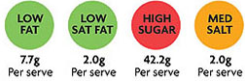
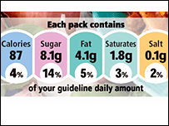
Nutrition Labelling
Look out for;
  Fat & saturated fat, sugar, salt
All food labels contain a nutritional analysis panel which is key to choosing a healthier diet
These will tell you how much of each nutrient there is in a single portion and /100 grams
Eg: Biscuits, snacks etc
Notes:
Food manufacturers portion sizes may be different to ours!
Government are in the process of working with food manufacturers to bring in a UK wide traffic light system to reduce confusion around food labelling and differences in branded labels
Can find info

Slide 29
The Media
Health claims often reported
in the media
Sponsored studies → biased results

Slide 30
Summary
Hopefully now you feel informed about what a ‘healthy lifestyle’ means and are able to identify health behaviours you could incorporate into your lifestyle
Eat sensibly, choosing a range of foods in the correct proportions
Move often
Drink moderately
If you smoke, try to stop
Notes:
If you would like more in depth, tailored advice about your diet or specific medical condition ask your GP to refer you to a dietitian

Slide 31
Thank you for listening
Any questions?

